Slide 1
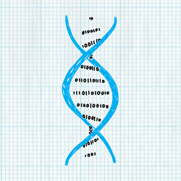
February, 2022
Science of Living System
BS20001 (2-0-0)
Dibyendu Samanta
School of Bio Science
Email: dibyendu.samanta@iitkgp.ac.in
Tel: 03222-260295

Slide 2
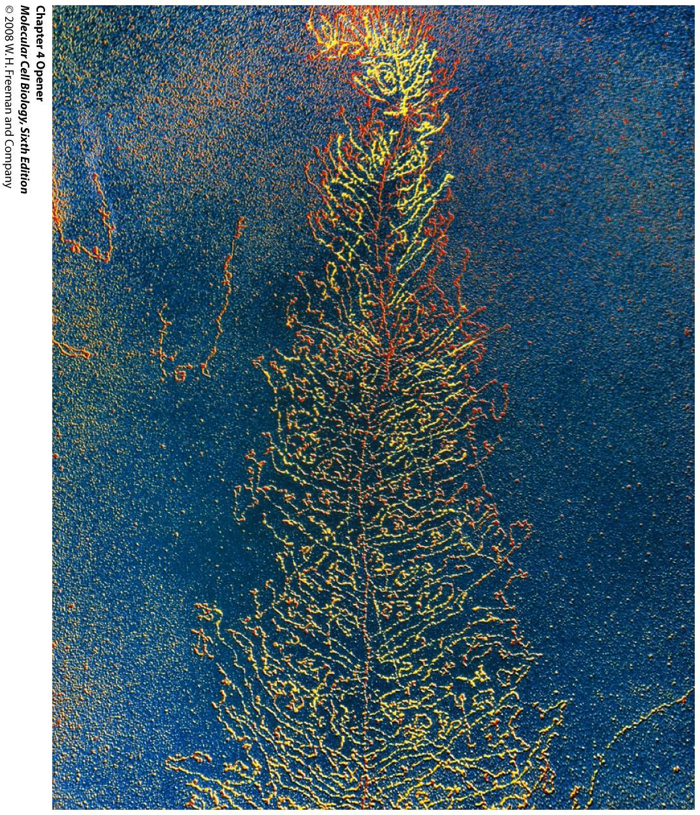
Overview of Transcription and Translation

Slide 3
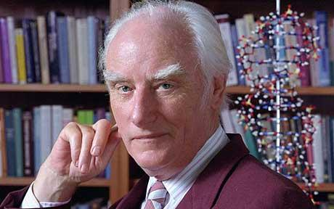
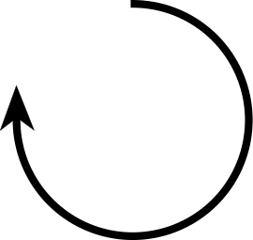
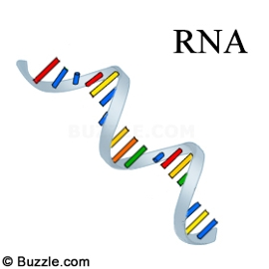
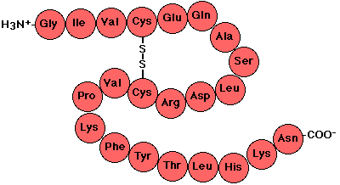
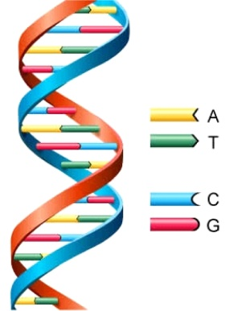
Flow of Genetic Information: The Central Dogma of Molecular Biology
DNA Polymerase
RNA Polymerase
Nobel Prize in 1962 for DNA Structure
Ribosome
DNA
RNA
Protein
Transcription
Translation
Replication
DNA
RNA
Protein
Polymer of nucleotides
Polymer of nucleotides
Polymer of amino acids

Slide 4
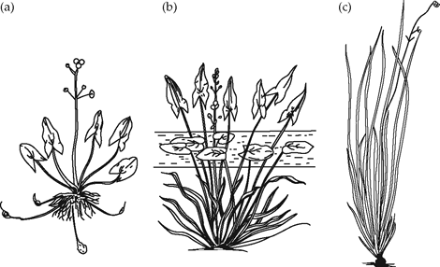
DNA: Contains the Instruction for Life
Hoxc8
Plant-X
Plant-Y
Plant-Z
Completely terrestrial Partially submerged Completely submerged
The phenotype (visible configuration) of the marsh plant Sagittaria sagittifolia depends on its environment

Slide 5
Correlations Between DNA Content and Its Down-stream Product
Transcription
Translation
DNA
RNA
Protein

Slide 6
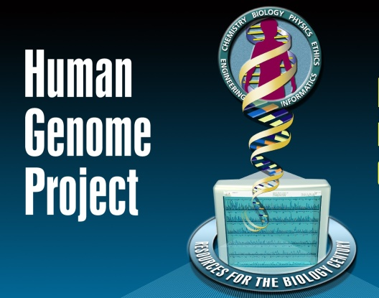

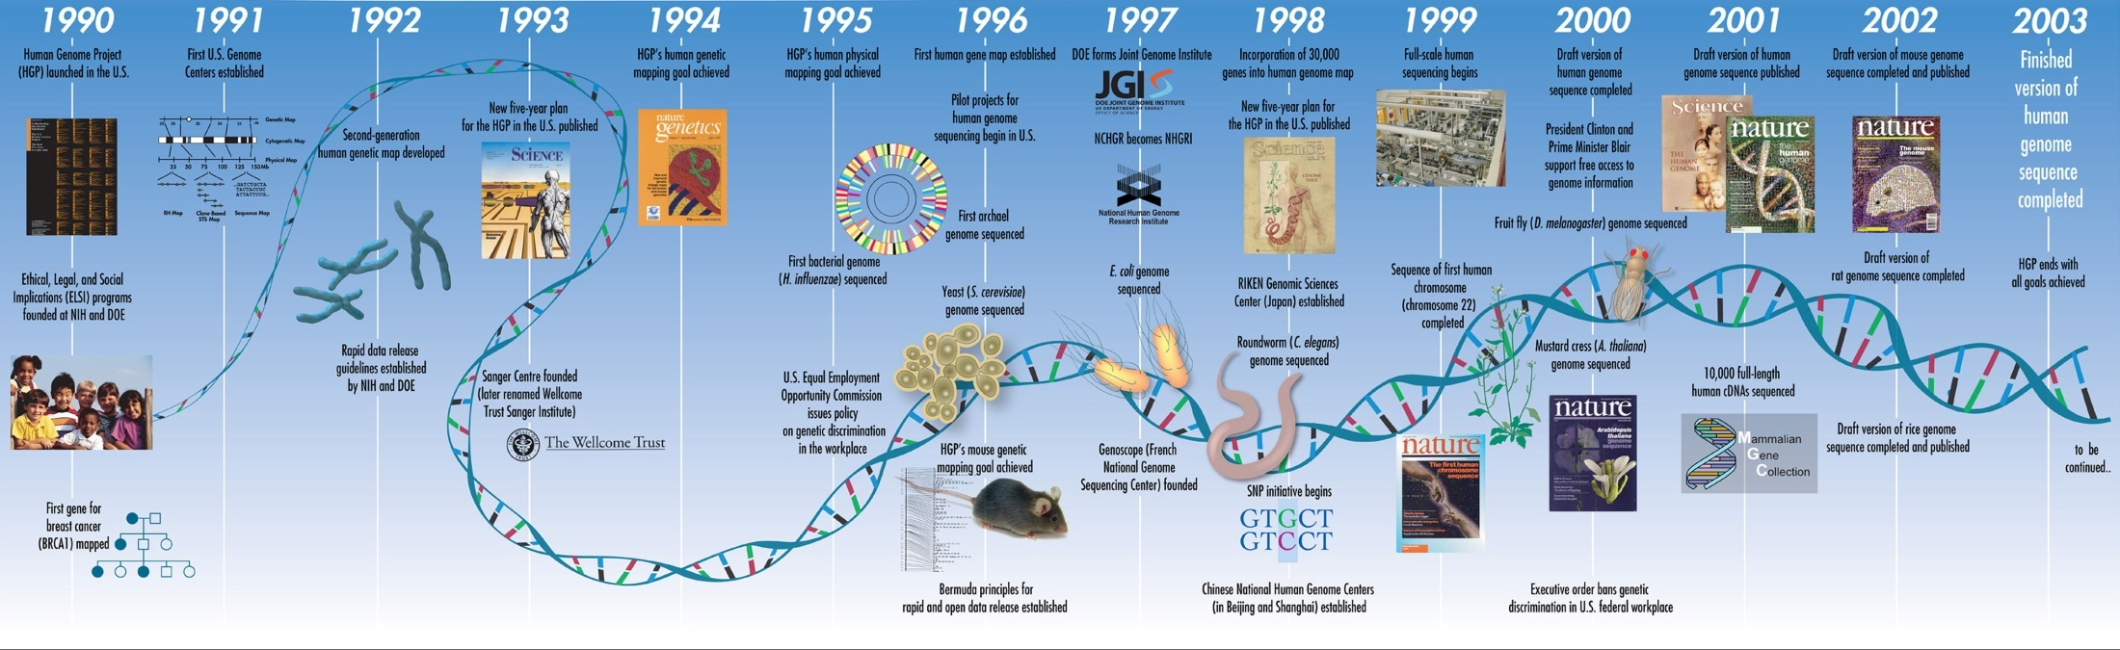
“Human Genome Project” Dramatically Enhanced Our Understanding on Gene Expression
∼21,000 human genes (appeared to be significantly fewer than previous estimates)

Slide 7
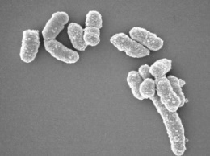
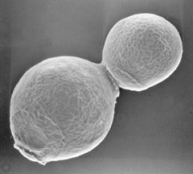
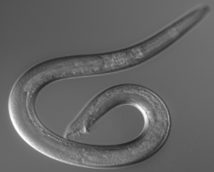
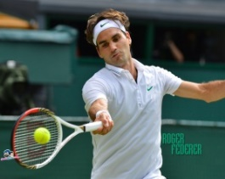
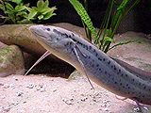
Genome Size, Gene Number, and Complexity of an Organism
Organism Genome size (bp) Protein coding genes
E. coli 4,600,000 4,250
S. cerevisiae 12,160,000 5,616
C. elegans 100,000,000 19,735
Human 3,200,000,000 19,042
Marbled lungfish 139,000,000,000 NA

Slide 8


Transcription
Genome size (bp)
Total DNA content vs transcribable content
4,600,000
3,200,000,000
►Protein coding sequences is ~1.5% of total DNA content (human)
Messenger RNA (mRNA)
►Besides protein coding region, DNA can be transcribed into:
Ribosomal RNA (rRNA)
Transfer RNA (tRNA)
►Most of the DNA sequences are not transcribed

Slide 9
What is a Machine?
A piece of equipment with several moving parts that uses power to do a particular type of work.
Cambridge dictionary
Biological machines:
DNA polymerase
RNA polymerase
Ribosome

Slide 10
Transcription: Involved Machineries and Processes
Promoter
Start
Stop
gene
Key points to be discussed
Promoter
RNA Polymerase
RNA synthesis
RNA Polymerase
5’
3’
3’
5’
5’
Initiation
Elongation
Termination
3’
5’
Nascent mRNA

Slide 11
Promoter for Transcription
Promoter is just like a “pointer” that points to the location of the information (gene) to be copied into mRNA
-10
+1
Coding strand
5’
TATAAT
ATTGCGATGG
3’
Template strand
3’
Promoter
TAACGCTACC
5’
5’
3’
Prokaryotic promoter
AUUGCGAUGG
-25
+1
Coding strand
5’
TATAAA
AGTGCTATGG
3’
Template strand
3’
TATA box
(Promoter)
TCACGATACC
5’
Eukaryotic promoter

Slide 12
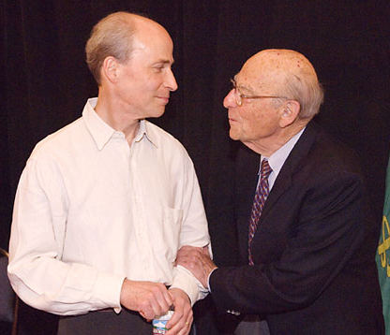
RNA Polymerase
Subunits of RNA Polymerase: α, α, β, β’ and σ
Holoenzyme: α, α, β, β’ and σ
Coreenzyme: α, α, β and β’
β’
gene
β
σ
Roger Kornberg
Nobel Prize in 2006
α
α
►RNA polymerase is completely Processive: A transcript is synthesized from start to end by a single RNA polymerase molecule.
σ
►RNA polymerase can initiate the synthesis of RNA de-novo (No primer required)
RNA Molecules in E. coli
Who transcribes this huge pool of rRNA and tRNA?
mRNA 5%
tRNA 15%
rRNA 80%
In bacteria same RNA polymerase transcribe all these three types of RNA
In eukaryotes different RNA polymerases are involved in transcription of mRNA, rRNA and tRNA
Notes:
Everything in eukaryotes is little more complex compare to bacteria. Although the basic architectures of these processes are same, in eukaryotes we have more communications between different steps, more tools to regulate the activities, and a number of alternate options.

Slide 13
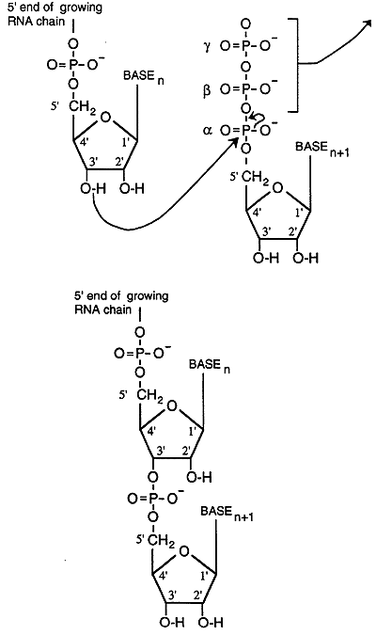
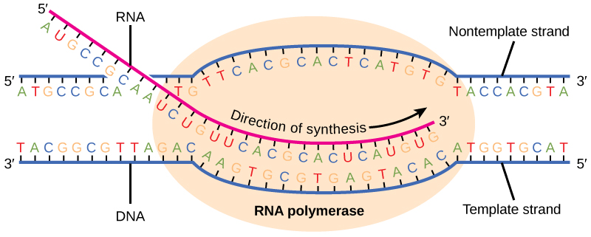
RNA Synthesis
Growing RNA chain
Coding strand
5’
+
3’
Ribonucleotide

Slide 14
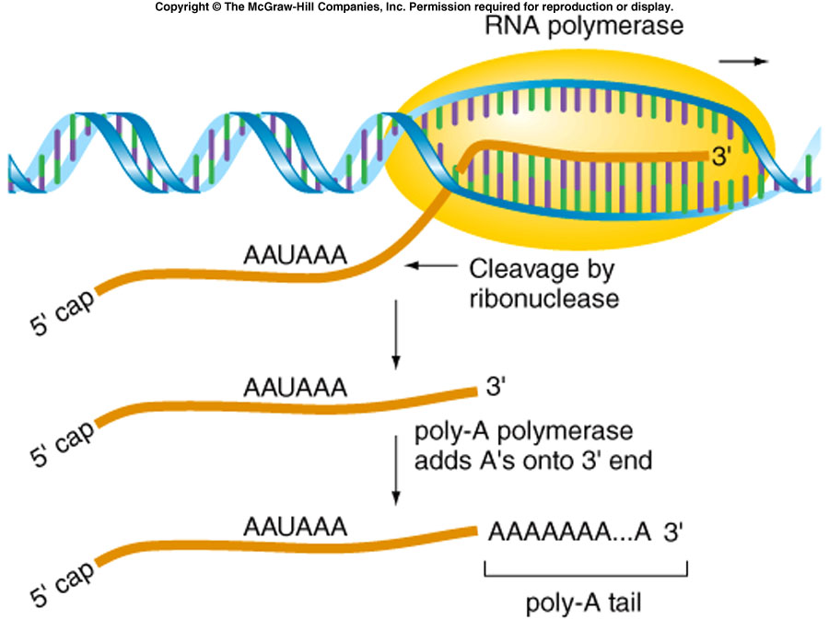
Eukaryotic Transcripts Need to be Processed
►Ends of a nascent mRNA acquire a 5’ cap and a 3’ poly A tail
●Increase stability of mRNA
●More effective template for translation

Slide 15
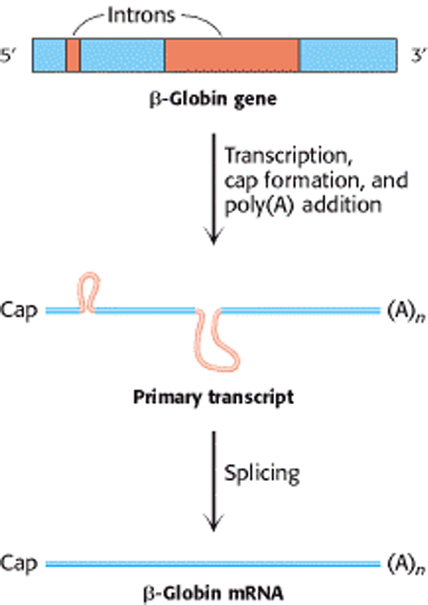
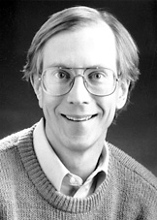
Eukaryotic Transcripts Need to be Processed
►Splicing (mediated by specialized enzymatic machineries consisting of snRNAs and proteins) removes introns from nascent mRNA
β-Globin gene
Transcription
Cap formation
Poly(A) addition
Thomas Cech
Nobel prize in 1989
Primary transcript
Splicing
**Splicing generates more variation
β-Globin mRNA

Slide 16
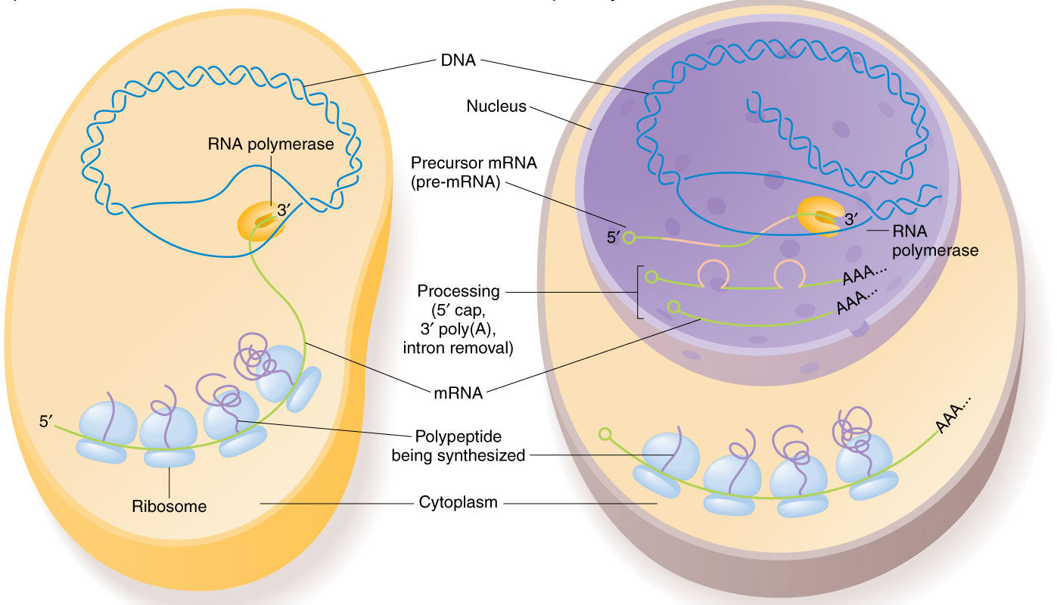
Transcription: At a Glance
Bacteria
Eukaryote

Slide 17
Regulation of Gene Expression
(Biological circuits)
0
1
1

Slide 18
Regulation of Gene Expression
Each cell contains all the genetic material for growth and development
Some of these genes are expressed all the time
Other genes are not expressed all the time. They are switched on an off at need

Slide 19
Lac Operon: A Classic Example of Bacterial Gene Expression Control
Operon: Cluster of genes, related by function, regulated by a single promoter and transcribed into one mRNA (polycistronic).
RNA Polymerase
mRNA
lacZ
lacY
lacA
promoter
Lac Operon
lacZ | β-galactosidase | Breaks lactose into galactose and glucose.
lacY | lactose permease | Imports lactose into the bacterial cell.
lacA | thiogalactoside transacetylase | Cell detoxification.

Slide 20
Functional Outcome of Lac Operon
RNA Polymerase
Transcription
lacZ
lacY
lacA
promoter
Ribosome
Thiogalactoside
transacetylase
Polycistronic
mRNA
lactose permease
β-galactosidase

Slide 21
Lac repressor is a negative regulator of the Lac operon
RNA Polymerase
Lac repressor
lacZ
lacY
lacA
Lac operator
Lac Operon
lacZ | β-galactosidase | Breaks lactose into galactose and glucose.
lacY | lactose permease | Imports lactose into the bacterial cell.
lacA | thiogalactoside transacetylase | Cell detoxification.

Slide 22
Lactose (Allolactose) Can Displace Lac Repressor From the Operator Site
RNA Polymerase
Lac repressor
lacZ
lacY
lacA
Lac operator
Lac Operon
Lac repressor
Lac repressor
Allolactose
(Inducer)
Lac operator
Lac operator

Slide 23
Four Possible Situations
Glucose | Lactose | Lac repressor bound | Lac operon
1 | 0 | YES | OFF (0)
1 | 1 | YES | OFF (0)
0 | 1 | NO | ON (1)
0 | 0 | YES | OFF (0)
RNA Polymerase
Lac repressor
lacZ
lacY
lacA
Lac pomoter
Lac operator
Lac Operon
NOT
Glucose
AND
Lac Operon
Lactose

Slide 24
Translation
Translation
DNA
RNA
Protein
Polymer of nucleotides
Polymer of nucleotides
Polymer of amino acids

Slide 25
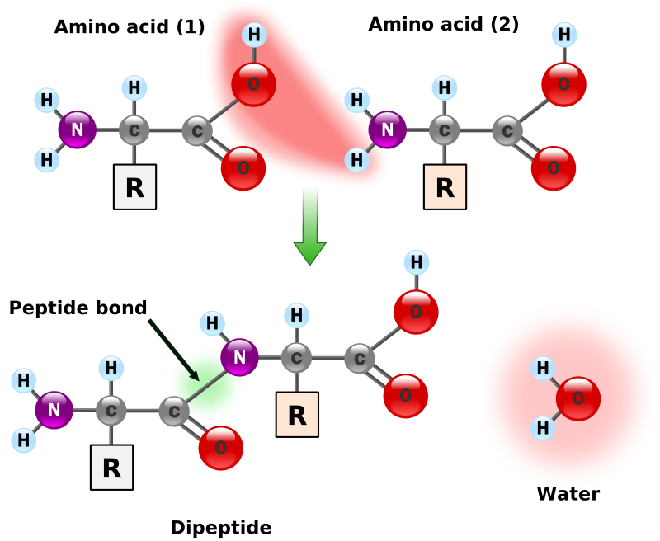
How Amino Acids are Linked Together
1
2
3
4
5
6
Polymer: Polypeptide and Protein
Monomers
(amino acids)
Peptide bonds

Slide 26
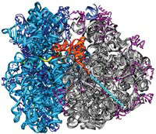
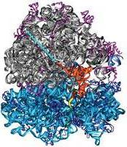
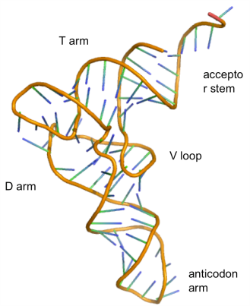
Translation
Template for protein synthesis
Protein synthesizing machinery
5’
3’
mRNA
Ribosome: (rRNA + proteins)
5’UAAGGAGA
(RBS)
AUCGUCAUGAAGAGGCCC…….UAAUUA 3’
30S
Start codon
Stop codon
50S
Met─Lys─Arg─Pro……
Polypeptide
23S rRNA
5S rRNA
34 proteins
16S rRNA
21 proteins
Nascent polypeptide
5’UAAGGAGA
AUCGUCAUGAAGAGGCCC…….UAAUUA 3’
►In Eukaryotes, 5’ 7mG cap is recognized by ribosome
tRNA

Slide 27
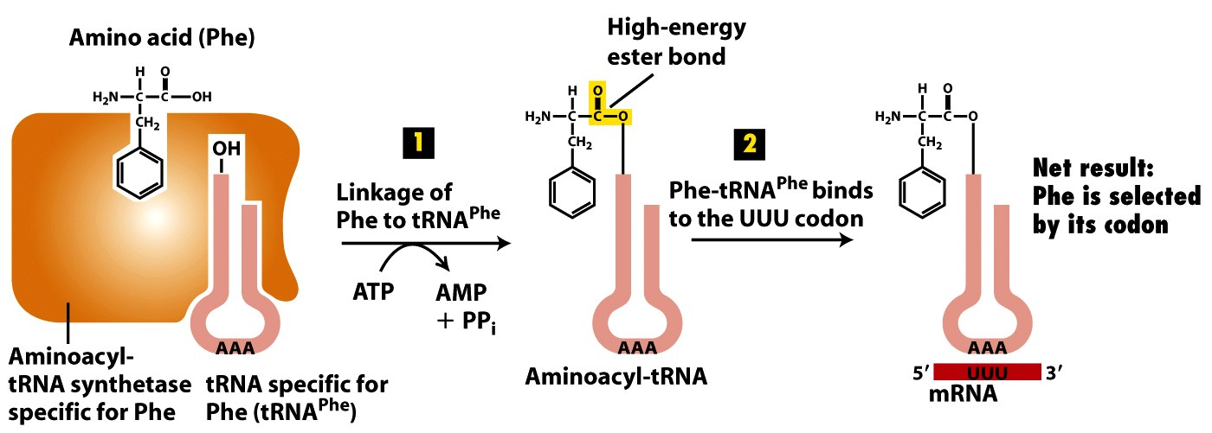
How Correct Amino Acids are Selected During Protein Synthesis

Slide 28
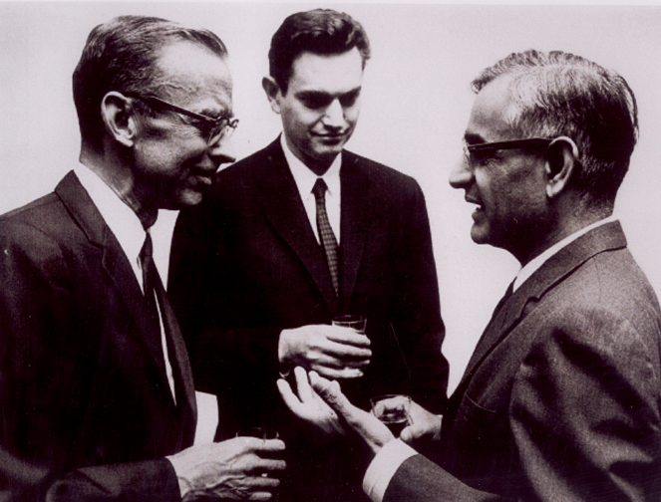
Genetic code
Genetic code is the relation between the sequence of bases in DNA (or its RNA transcripts) and the sequence of amino acids in proteins
A codon is a set of 3 nucleotides that specifies a particular amino acid
Why three nucleotides?
64 Codons present. Three of them (UAA, UAG, UGA) can’t code any amino acids, called STOP codons
AUG serves as the “initiator” or “start codon, which starts the synthesis of a protein
We have 61 codons that code for amino acids, and we have 20 amino acids. So, multiple codons may specify a single amino acid
Khorana, Nirenberg, Holley
Nobel Prize in 1968
Notes:
A three-letter code is used because there are 20 different amino acids that are used to make proteins.
If a two-letter code were used there would not be enough codons to select all 20 amino acids.
That is, there are 4 bases in RNA, so 4² (4x 4)=16; where as for 3 lettered code the number is 4³ (4x4x4)=64.

Slide 29
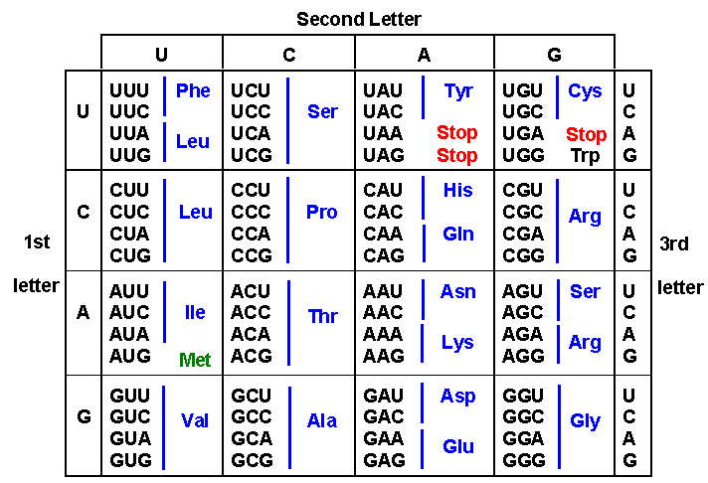
Genetic code

Slide 30
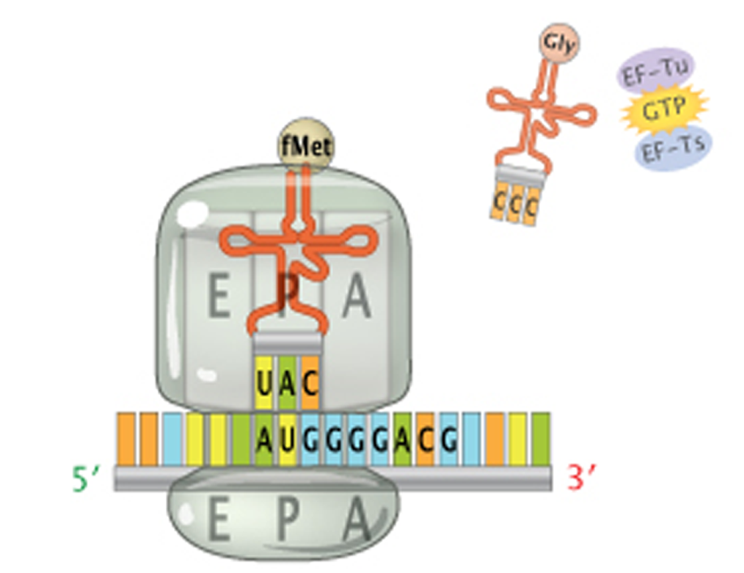
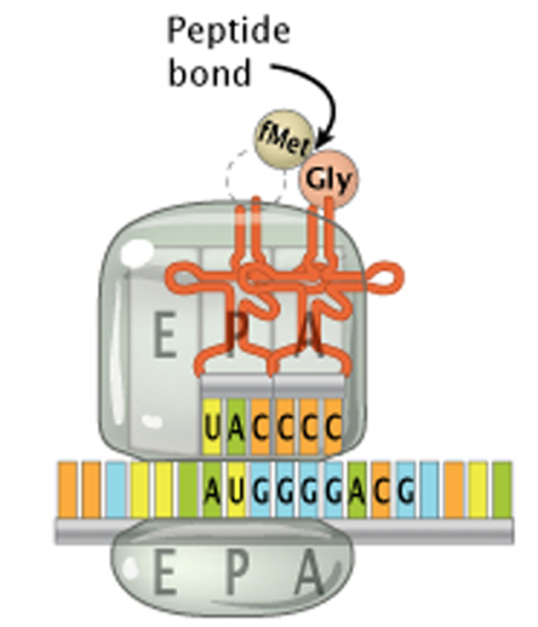
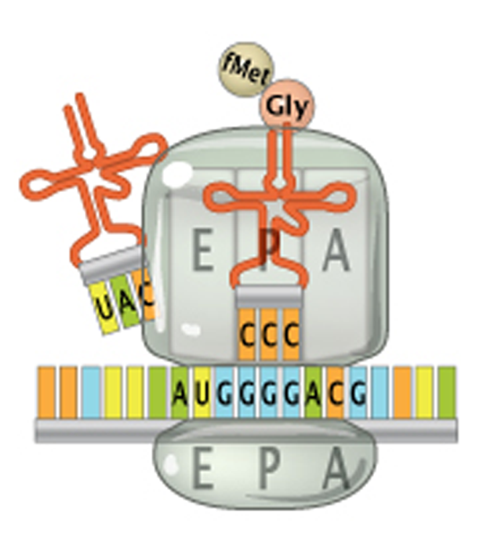
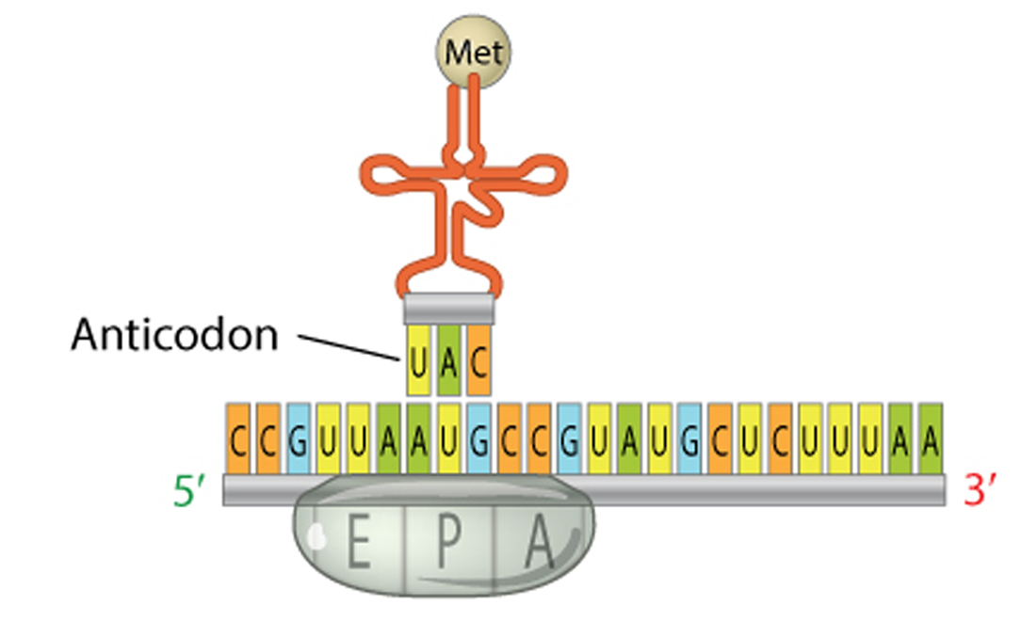
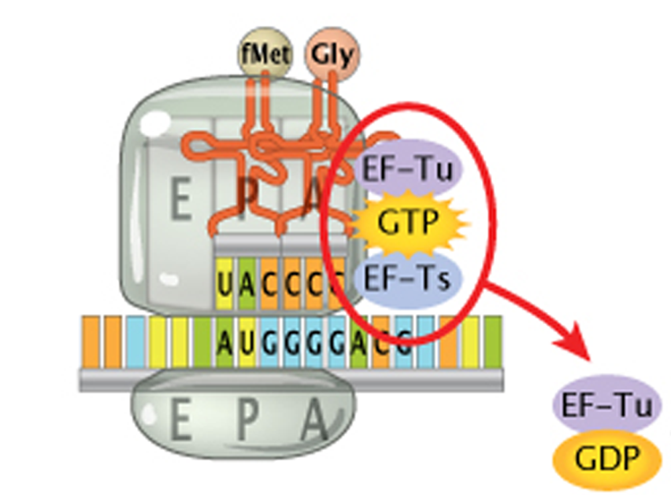
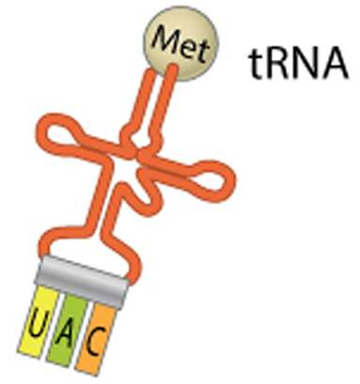
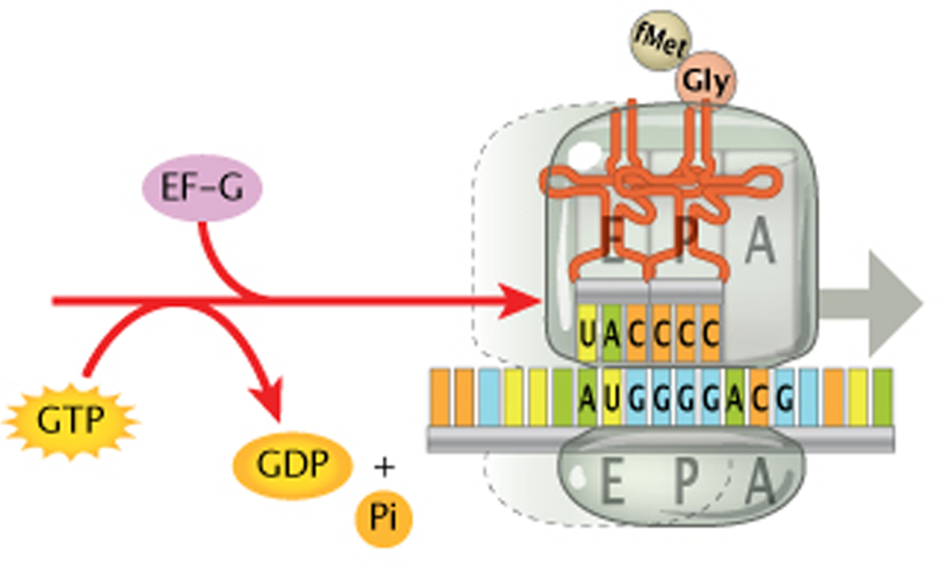
Translation: Involved Machineries and Processes
mRNA
Ribosome
Amino acid
tRNA
mRNA
30S ribosome
50S ribosome
Next charged tRNA and associated translation factors enter the A site
tRNA^{fMet} occupies the P site of the ribosome
The ribosome moves down the mRNA to the next codon and the uncharged tRNA now in the E site
E site tRNA releases and A site is now ready to receive another tRNA
Peptide bond forms between the aa in the P and A sites, and the tRNA in the P site releases its aa

Slide 31
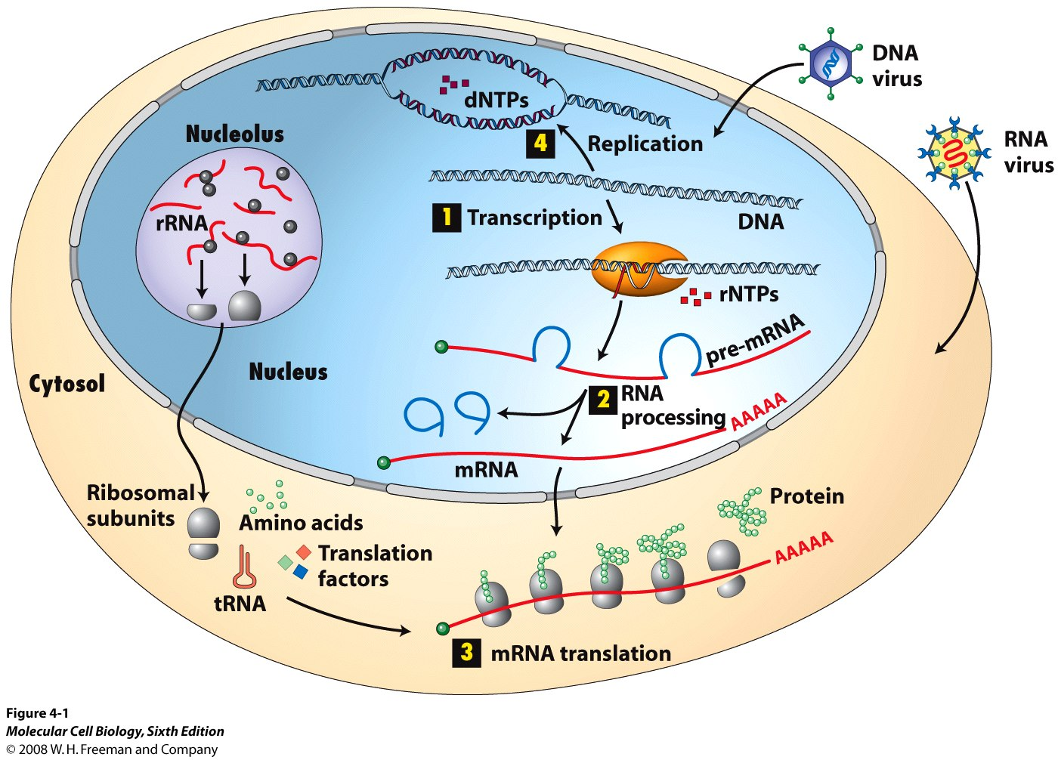
Translation: At a Glance

Slide 32
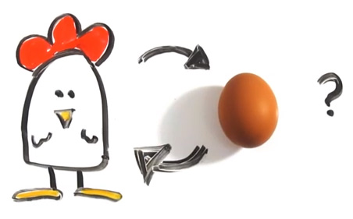

Which Came First? Nucleic acids or Proteins
DNA Polymerase
RNA Polymerase
Ribosome
DNA
RNA
Protein
Transcription
Translation
Replication
►RNA has enzymatic activity

Slide 33
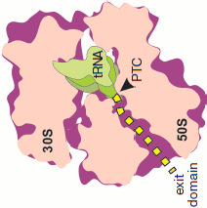
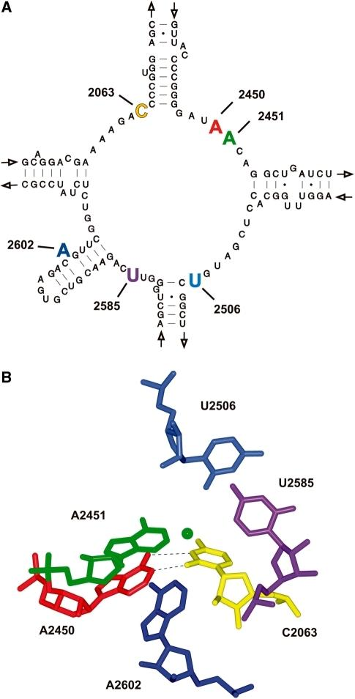
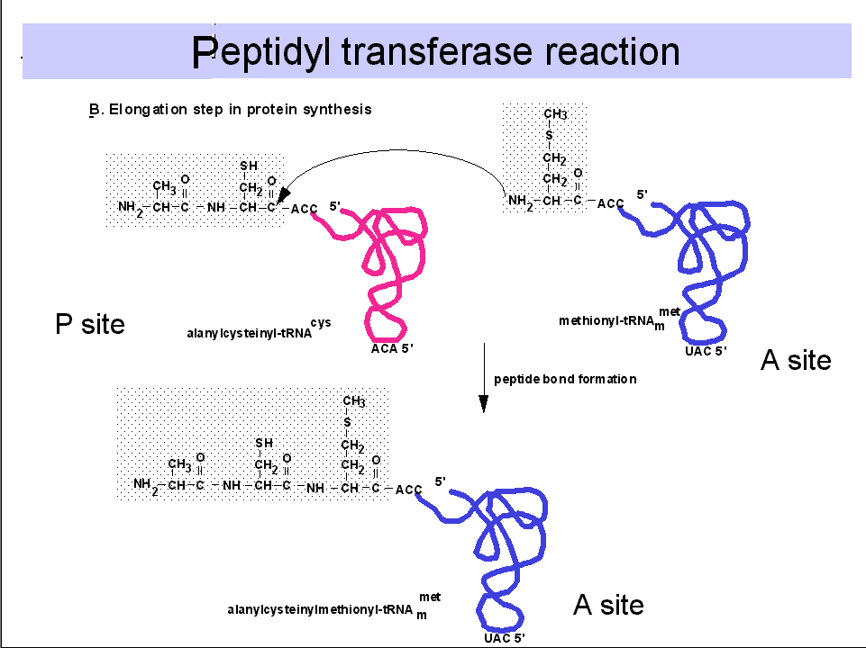
What Happens Inside the Ribosome? Chemical and Physical Consideration of Protein Synthesis
Peptidyl transferase reaction
Ala - Cys
tRNA^{Met}
Ala - Cys - Met
Peptidyl transferase center

Slide 34
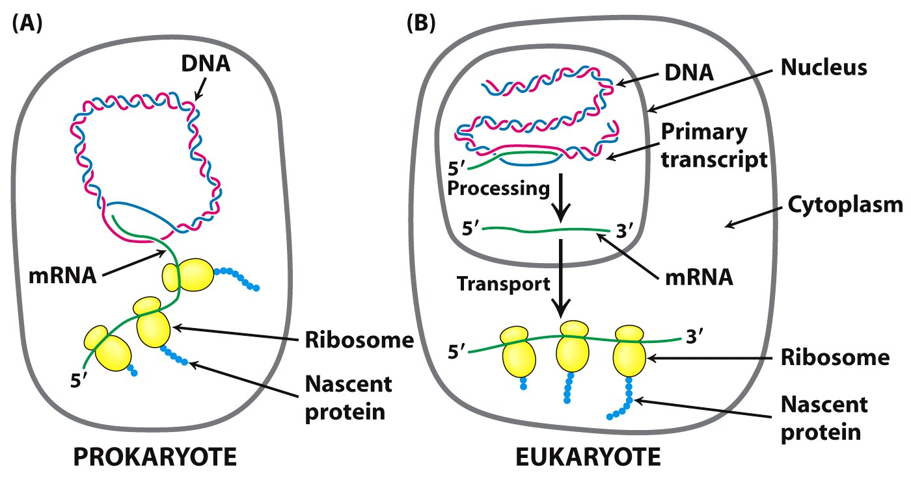
Time, Space and Correlation between Transcription and Translation
Notes:
Mention about movement of mRNA instead of ribosome when translated by ER-bound ribosomes

Slide 35
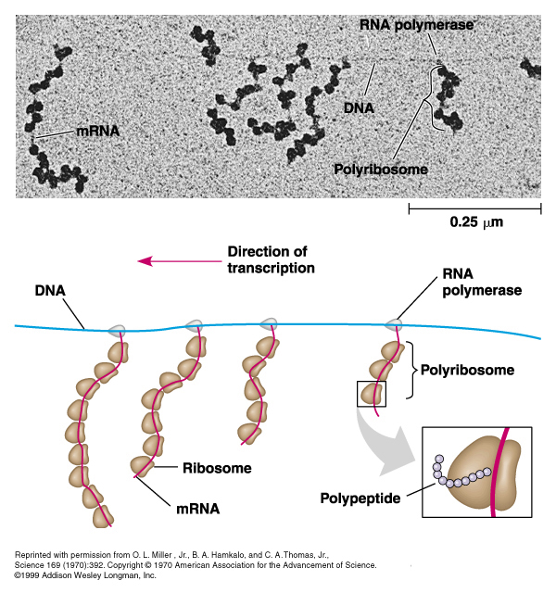
Time, Space and Correlation between Transcription and Translation
Notes:
Mention about movement of mRNA instead of ribosome when translated by ER-bound ribosomes

Slide 36
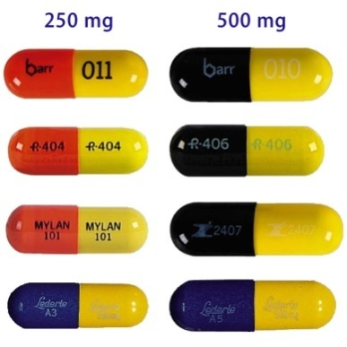

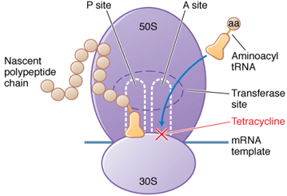
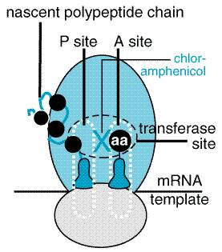
Translation Machineries: Attractive Targets For Therapeutics
Tetracycline
Chloramphenicol
Binds to the 30S ribosome, and blocks binding of aminoacyl-tRNA to the A-site
Blocks the peptidyl transferase reaction on 50S ribosomes
Streptomycin | Binds to the 30S ribosome, prevents the transition from initiation to chain-elongation
Erythromycin | Binds to the 50S ribosome, and blocks the translocation
Why ribosome is an attractive target for the development of antibiotics?

Slide 37
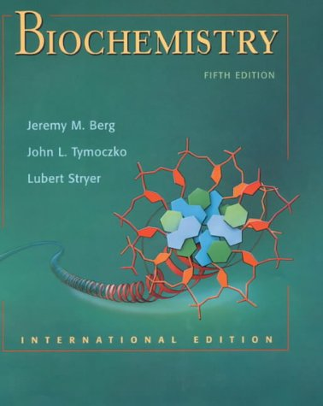
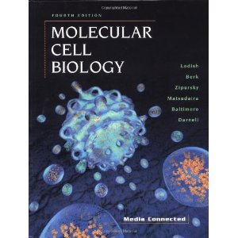
Suggested Textbook…
Stryer…
Baltimore, Lodish..

Slide 38
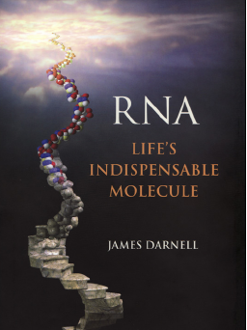
Extra Resources
Further Reading...
Videos…
mRNA synthesis (Transcription)
https://www.youtube.com/watch?v=_C9Un4dlpR4
Protein synthesis (Translation)
https://www.youtube.com/watch?v=Ikq9AcBcohA
Overview
https://www.youtube.com/watch?v=gG7uCskUOrA
James Darnell

